Slide 1
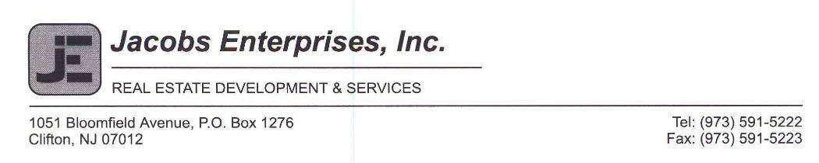
Case Study
AICPA Real Estate Conference 2011
Redevelopment of an old Supermarket into a new Pharmacy and Restaurant
wealthyville, NJ

Slide 2
Deal Summary
Existing 20,000 sf building had been vacated by its major tenant, but the lease had not been relinquished. Rent continued to be paid on the vacant space but other lease obligations were not being met.
Pressure built from the municipality and the other tenants to do something as deterioration, both physical and economic, had set in.
Landlord sought to enforce lease provisions regarding physical maintenance, and simultaneously work out a sublease or recapture deal with tenant-in-possession. Efforts failed and court action ensued.
Case explores how the site was “acquired” by Landlord (i.e., how was possession secured.)
Case goes on to explore redevelopment economics and entitlements and other aspects of a redevelopment deal.

Slide 3
acquisition

Slide 4
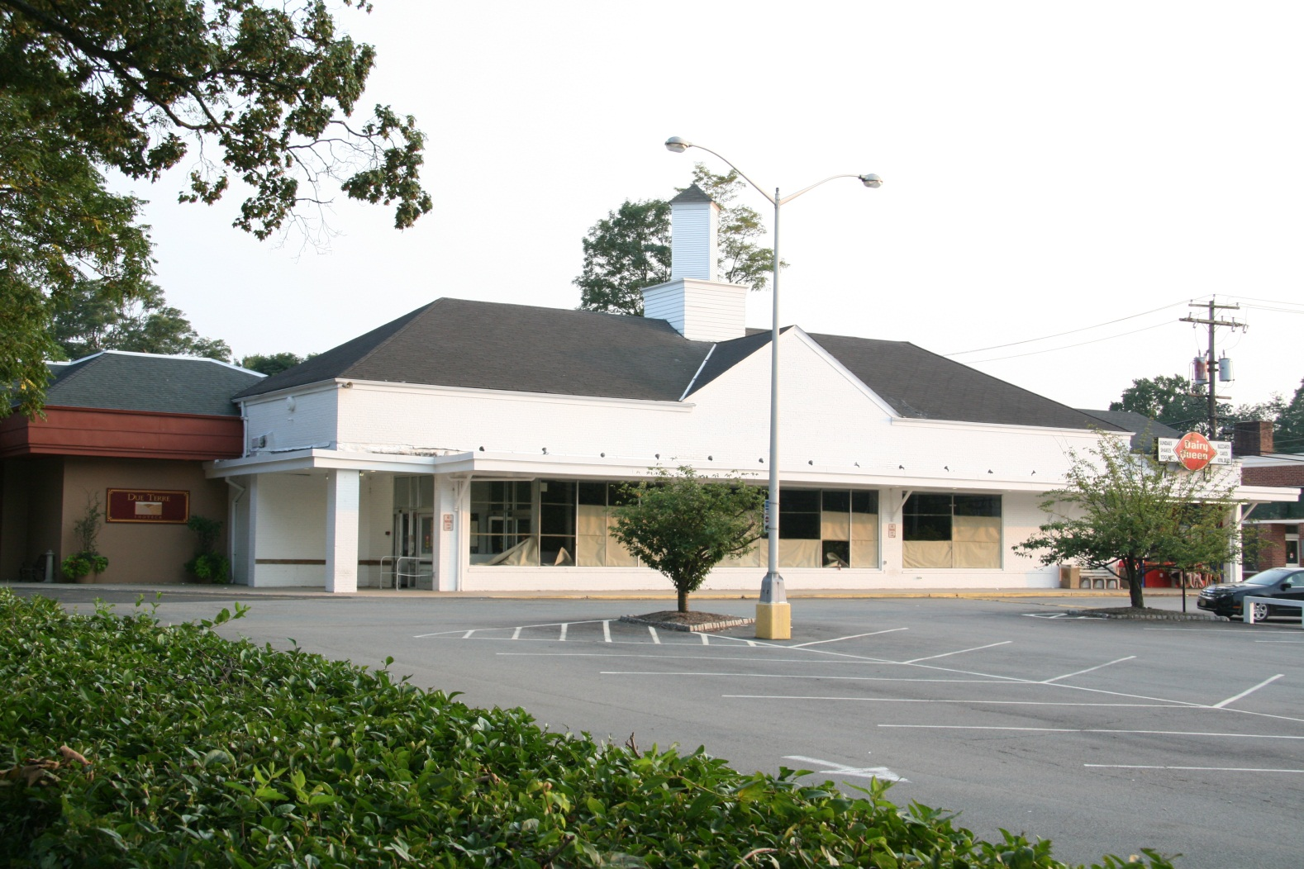
Existing Building

Slide 5
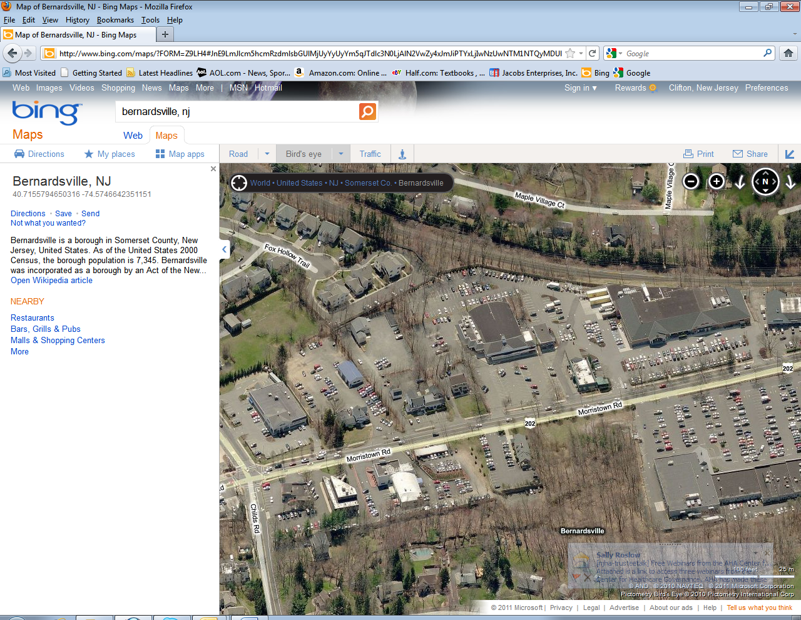
Neighboring Shopping Center including Supermarket
subject
supermarket

Slide 6
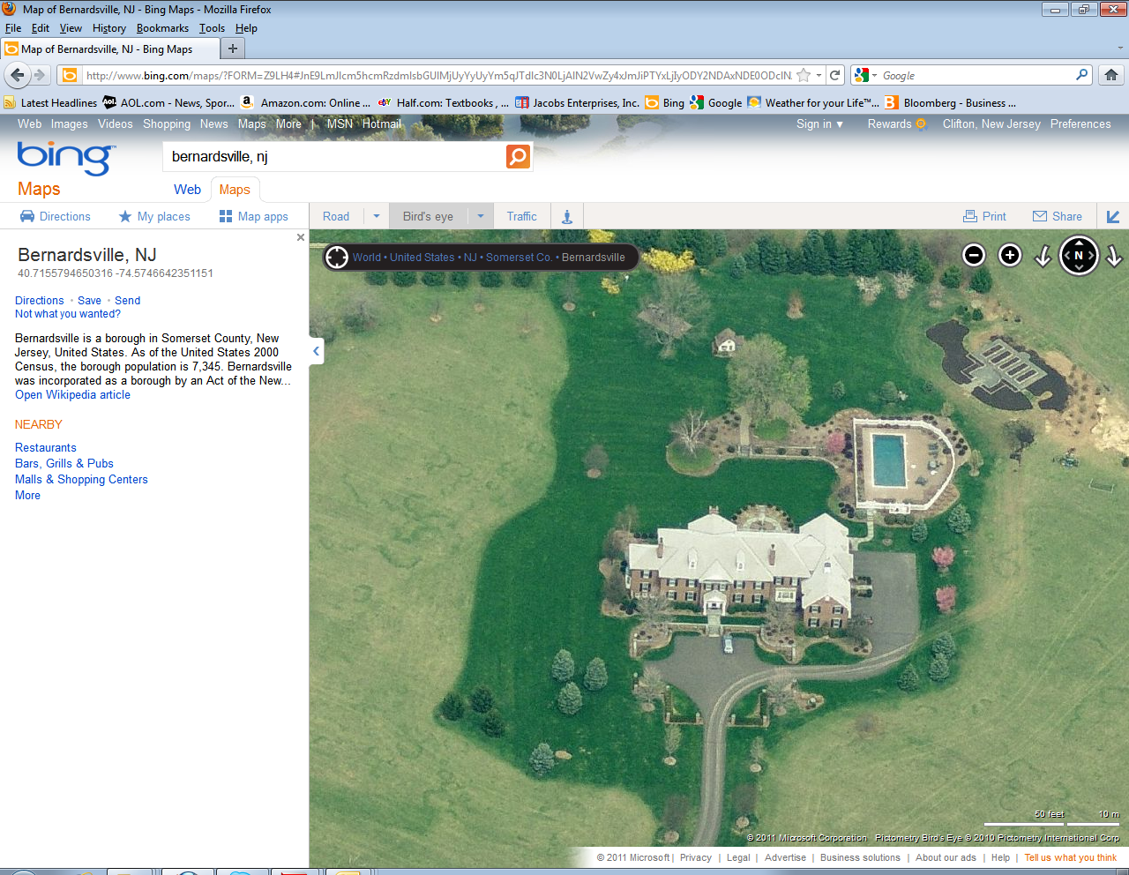
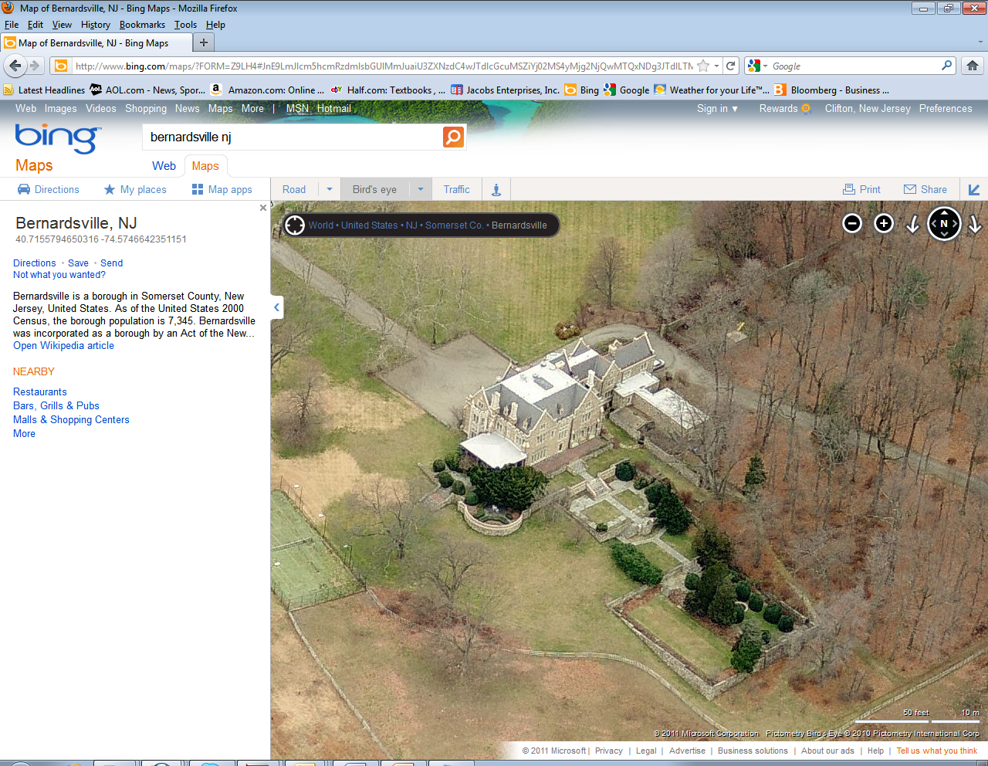
Sample homes in community

Slide 7
Lease Comparison – Structural Repair
This Lease started as revisions on a 2x previously signed lease. Nonetheless, it was heavily negotiated with the focus being on structural repair obligations.
This Lease was signed in the 1980s and contains significantly strong Landlord language. The building, being built in the 1960s, had repair needs then, but the Tenant agreed to take them on.
New Pharmacy Lease
Except as otherwise expressly provided herein, Landlord shall make, at no cost or expense to Tenant but without limiting Tenant’s reimbursement obligations set forth in Section 33, all necessary repairs, maintenance or replacements to the structural portions of the Premises and the Building, which are defined to include the roof and roof supports, flashings, gutters, downspouts, footings, foundations, structural supports, structural columns, exterior walls, bearing walls, foundation walls, and the basement floor slab, so as to keep the same in good condition and repair; and Landlord shall further maintain in good working order and repair, and shall maintain and replace as necessary, all plumbing, pipes, tubes and all other conduits and utility lines to the points of connection to or from the Premises (but not within the Premises) and, to the extent same exists, any Building-wide fire sprinkler system which may be located in or outside of the Premises; provided, however, that the foregoing shall be subject to the provisions of subsection 9(f) below.
(emphasis added)
Existing Supermarket Lease
The Tenant has examined the demised premises, including roof and agrees to accept same “as is” upon the commencement of this lease term (except as other wise provided herein) and without any representations on the part of the Landlord or its agents as to the present or future condition of the said premises with respect to habitability. The Tenant at its sole cost and expense shall keep the demised premises, exterior and interior, structural and non-structural, in good condition, and shall paint and renovate and repair and maintain the said premises as may be necessary, in Landlord’s opinion, reasonably exercised, to keep them and all items furnished by Landlord and Tenant in good repair and condition, including and not limited to heating and cooling facilities installed in the premises.
(emphasis added)

Slide 8
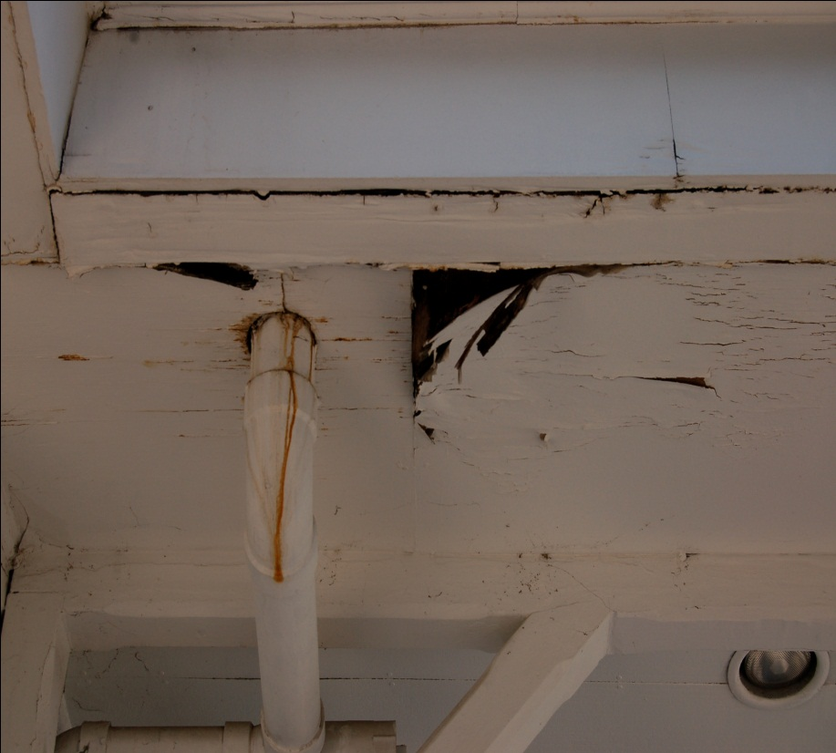
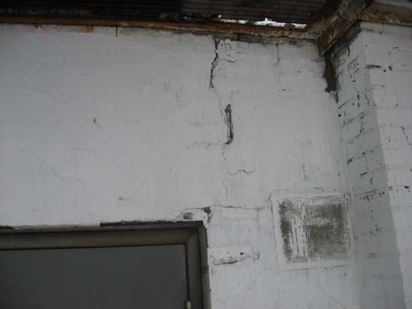
Damage Areas - Examples
Water and Structural damage
Exterior Façade and Canopy damage

Slide 9
economics

Slide 10
Economic Comparison
Existing Pro Forma
Tenant | Space | Current NNN Rent PSF | Rent
Income
Supermarket | 16,448.00 | $ 15.00 | $ 246,720.00
Restaurant | 3,363.00 | $ 27.58 | $ 92,764.00
Restaurant Expansion | - | $ 35.00 | $ -
Ice Cream Store | 1,107.00 | $ 35.46 | $ 39,258.00
Total | 20,918.00
Gross Income |  |  | $ 378,742.00
Expenses
Management | 5% |  | $ 18,937.10
Structural Reserve | $ 0.10 |  | $ 2,091.80
Total |  |  | $ 21,028.90
Net Operating Income |  |  | $ 357,713.10
Value - cap'd @ | 8% |  | $4,471,413.75
Note: this assumes 100% occupancy and complete pass-through of all Operating Expenses.
Stabilized Pro Forma, new Pharmacy and Restaurant Expansion
Tenant | Space | Current NNN Rent PSF | Rent
Income
Pharmacy | 12,800.00 | $ 35.00 | $ 448,000.00
Restaurant | 3,363.00 | $ 27.58 | $ 92,764.00
Restaurant Expansion | 2,000.00 | $ 35.00 | $ 70,000.00
Ice Cream Store | 1,107.00 | $ 35.46 | $ 39,258.00
Total | 19,270.00
Gross Income |  |  | $ 650,022.00
Expenses
Management | 5% |  | $ 32,501.10
Structural Reserve | $ 0.10 |  | $ 1,927.00
Total |  |  | $ 34,428.10
Net Operating Income |  |  | $ 615,593.90
Value cap'd @ | 6% |  | $10,259,898.33
Note: this assumes 100% occupancy and complete pass-through of all Operating Expenses.

Slide 11
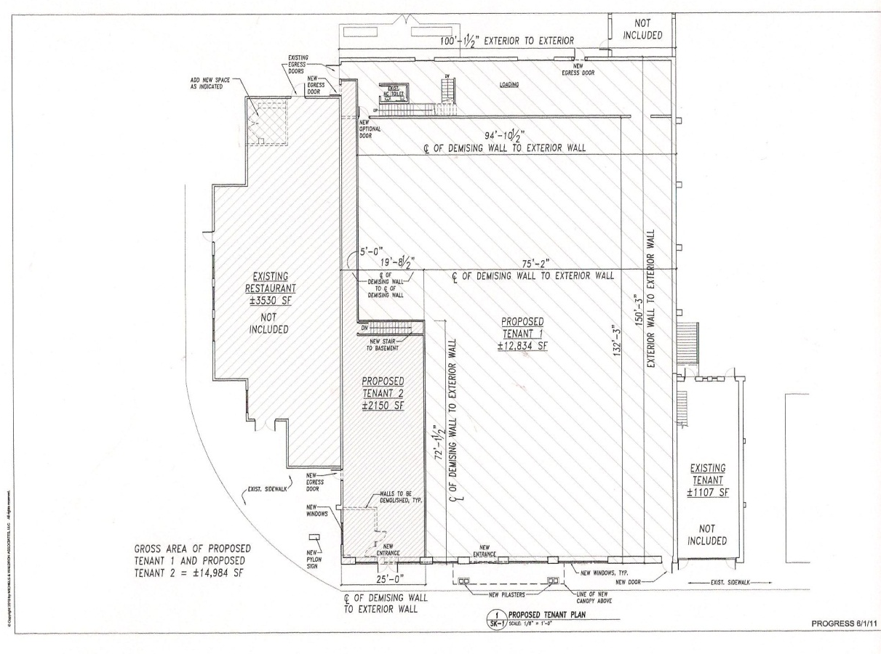
New leasing plan

Slide 12
Redevelopment budget
Development Budget
8/29/2011 13:20
 |  |  |  | Current Budget Numbers
 |  |  |  | 8/1/2011
Soft Costs
Architecture |  |  |  | $ 20,000
Structural Engineer |  |  |  | $ 10,000
Civil Engineer |  |  |  | $ 30,000
Mechanical Engineer |  |  |  | $ 10,000
Land Use Attorney |  |  |  | $ 15,000
Lease Attorney - Pharmacy |  |  |  | $ 125,000
Lease Attorney - Restaurant |  |  |  | $ 15,000
Leasing Commission |  |  |  | $ 263,000
 |  |  |  | $ 488,000
Contingency @ | 5% |  |  | $ 24,400
 |  |  |  | $ 512,400
Hard Costs
Branch Proposal* |  |  |  | $ 382,925
Demising Wall |  |  |  | $ 37,740
Utilities |  |  |  | $ 30,000
Storefront Allowance |  |  |  | $ 30,000
Seal Coat and Stripe Lot |  |  |  | $ 20,000
 |  |  |  | $ 500,665
Contingency @ | 10% |  |  | $ 50,067
 |  |  |  | $ 550,732
Development Fee |  |  |  | $ 50,000
Total |  |  |  | $ 1,113,132
Land | 3 | acres @ | $ 1,000,000 | $ 3,000,000
Building | 21000 | sf @ | $ 50 | $ 1,050,000
Total Investment |  |  |  | $ 5,163,132

Slide 13
Capital structure
Stabilized Pro Forma
Tenant | Space | Current NNN Rent PSF | Rent
Income
Pharmacy | 12,800.00 | $ 35.00 | $ 448,000.00
Restaurant | 3,363.00 | $ 27.58 | $ 92,764.00
Restaurant Expansion | 2,000.00 | $ 35.00 | $ 70,000.00
ADYA (Dairy Queen) | 1,107.00 | $ 35.46 | $ 39,258.00
Total | 19,270.00
Gross Income |  |  | $ 650,022.00
Expenses
Management | 5% |  | $ 32,501.10
Structural Reserve | $ 0.10 |  | $ 1,927.00
Total |  |  | $ 34,428.10
Net Operating Income |  |  | $ 615,593.90
Total Investment |  | $ 5,163,131.50
Cash on cash return |  |  | 11.92%
Debt Service
Interest Rate | 6.00%
Amortization | 25.00 | years
Debt Service Constant | -7.73%
Coverage ratio | 1.30
Potential Principal |  | $ 6,124,640.94
Amount borrowed |  | $ 1,500,000.00
Equity, not including land or building basis |  | $ 3,663,131.50
Debt Service |  |  | $(115,974.25)
Cash Flow Available for Distribution |  |  | $ 499,619.65
Return on Equity |  |  | 13.64%
Please note that the Land and Building have been owned for many years and the resultant basis is very low. The computations here are based on putative, not real, values. Also, the actual financing will be of incremental costs, not “value” so the cash-on-cash returns will be much higher.

Slide 14
Entitlements

Slide 15
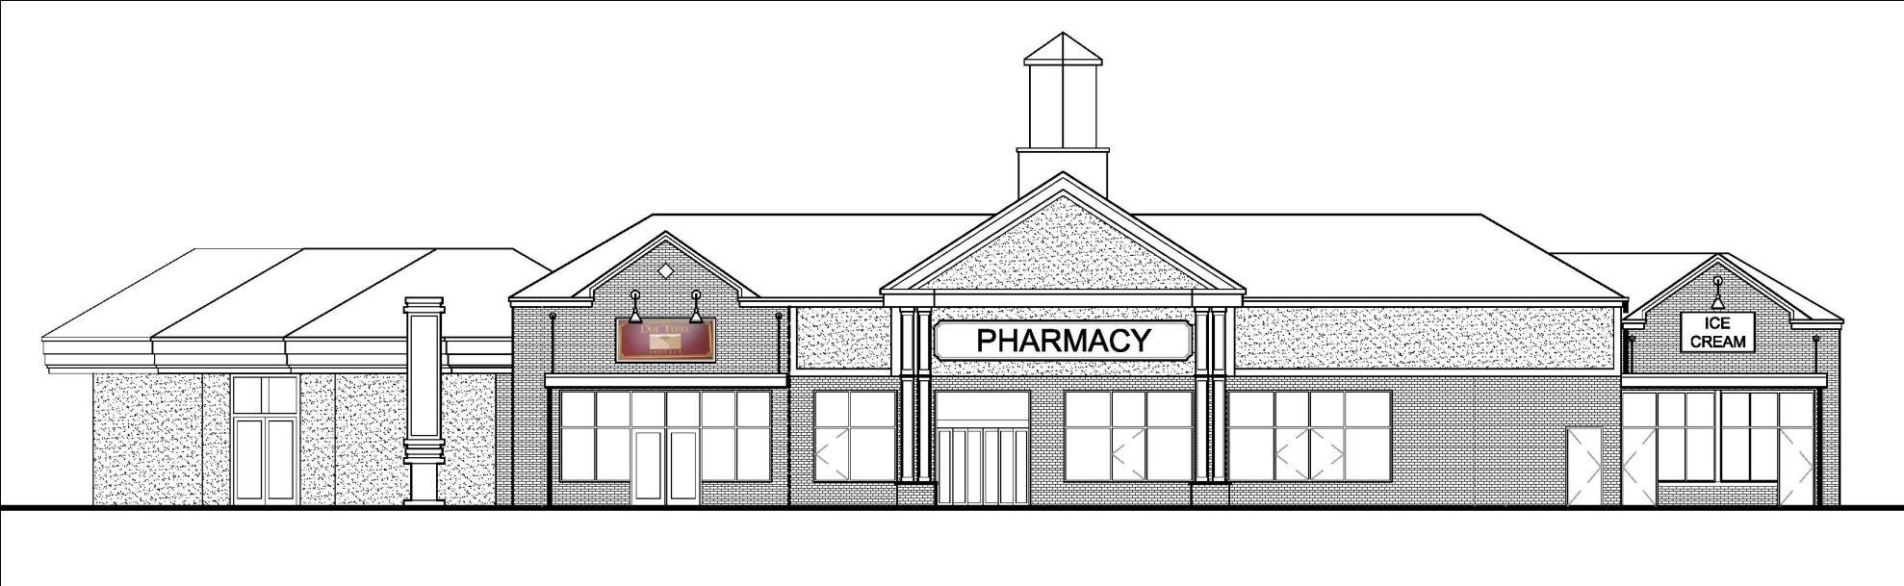
Rendering of redeveloped project
New project shows expanded restaurant, new pharmacy, and new façade and signage across entire building.

Slide 16
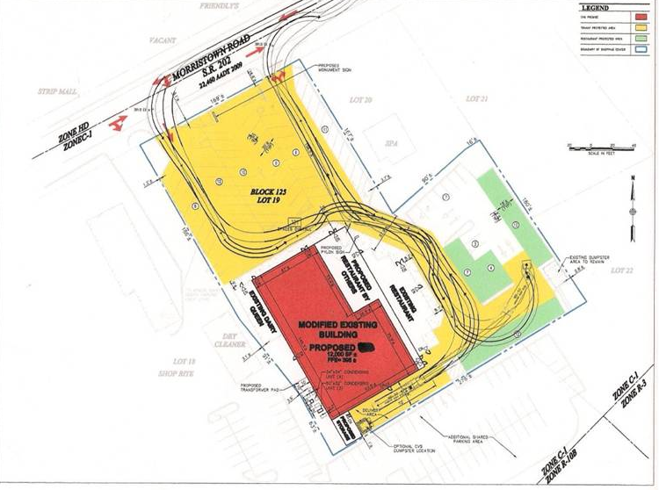
Proposed Site plan
    Show property limits and environmental issue

Slide 17
further
Complications

Slide 18
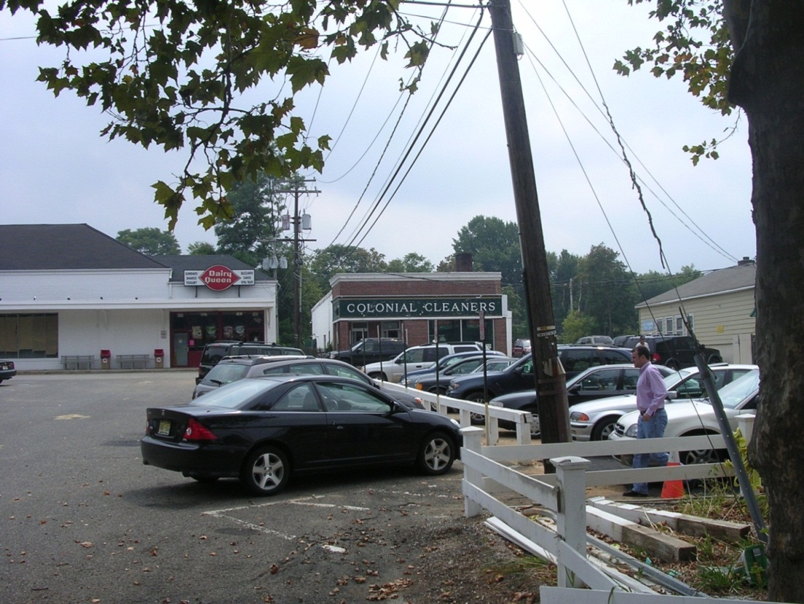
Dairy Queen and Dry Cleaner
The cleaner is outside the Property boundary. It has leaked contamination onto the Property from its cleaning processes. We are now in the first stage of both cleanup and litigation with the responsible parties.

